Slide 1
Learning Discrete Representations via Information Maximizing Self-Augmented Training
Weihua Hu et.al. ICML 2017

Slide 2

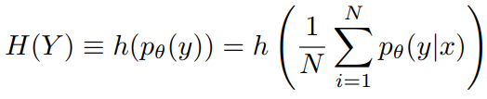
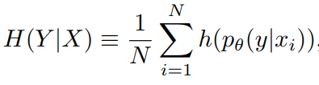
IMSAT for Clustering
Information Maximizing Self-Augmented Training(IMSAT)
Loss:
,where
In practice, an extra constraint is used, that’s because this method doesn’t work perfectly well. This constraint is not introduced here, because I think it’s just a workaround.
continuing
Symbols:
X: input image, or its feature
Y: cluster id, here assume known cluster numbers like K-means
N: sample numbers
My: for H(Y), p(y|x)= p(y|x)p(x)=p(x,y)=p(y), if treat p(x)=1
Note H(Y)-H(Y|X)=I(X;Y), so this loss wants maximize I(X;Y).
R_SAT(theta;T): regularization term, see next page.

Slide 3
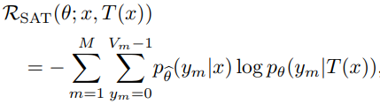


IMSAT for Clustering
It’s hard to imagine that only maximize I(X;Y) would work well. So the author also introduce a regularization term.
T(x): augmentation of x, it can be i) affine distortion such as rotation, scaling and parallel movement ii) local perturbation
: [y_1, y_2, y_i, ..., y_M] is the representation of x, [0, V_m] is y_i’s domain.
This R_SAT is cross entropy on p(y|x) and p(y|T(x)).
Don’t know difference between theta and hat theta now☹ continuing

Slide 4
IMSAT for Clustering
Summary
1. Maximize I(X;Y)
2. Minimize representation difference on sample and sample’s self-augmentation

Slide 5
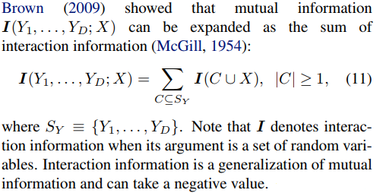
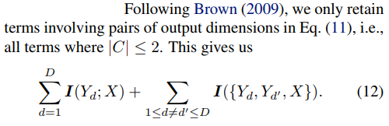
IMSAT for Hash Learning
IMSAT for cluster is that it maps an image to cluster id (scalar), while IMSAT for hash learning is that it maps an image to a D-bit-binary code(vector).
For the hashing process, it simply perform element-wise sigmoid on image’s feature vector, to get D-bit-binary code from a network. code: query_hash = F.sigmoid(enc(x_query, test=True)).data > 0.5
For I(X;Y), Y is multivariable now, as I(X;Y_1, Y_2, …Y_D). This is much harder to solve than I(X;Y), so the author do as follows:

Slide 6
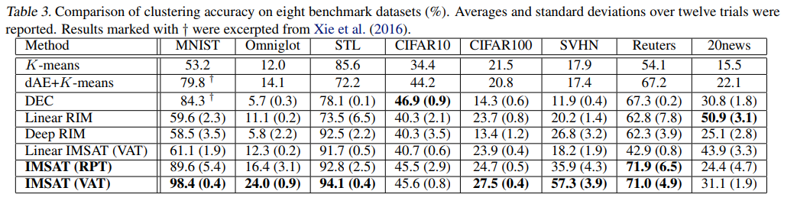
Numbers
I don’t know the metric.
Random Perturbation Training (RPT) Virtual Adversarial Training (VAT) two kinds of perturbation method.

Slide 7
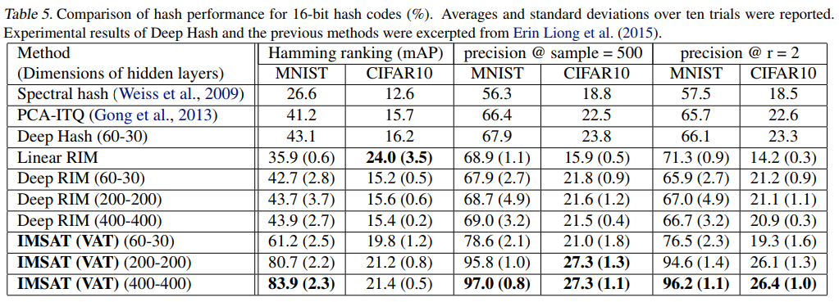
Numbers
I don’t know the metric.
Random Perturbation Training (RPT) Virtual Adversarial Training (VAT) two kinds of perturbation method.

Slide 8
Code
https://github.com/weihua916/imsat

